Slide 1
Data Structures Project Review
MEPCO SCHLENK ENGINEERING COLLEGE, SIVAKASI
TIC-TAC-TOE
Presented By:
Bhuvana S

Slide 2
OBJECTIVE:
Implementation of tic tac toe using python language and GUI.

Slide 3
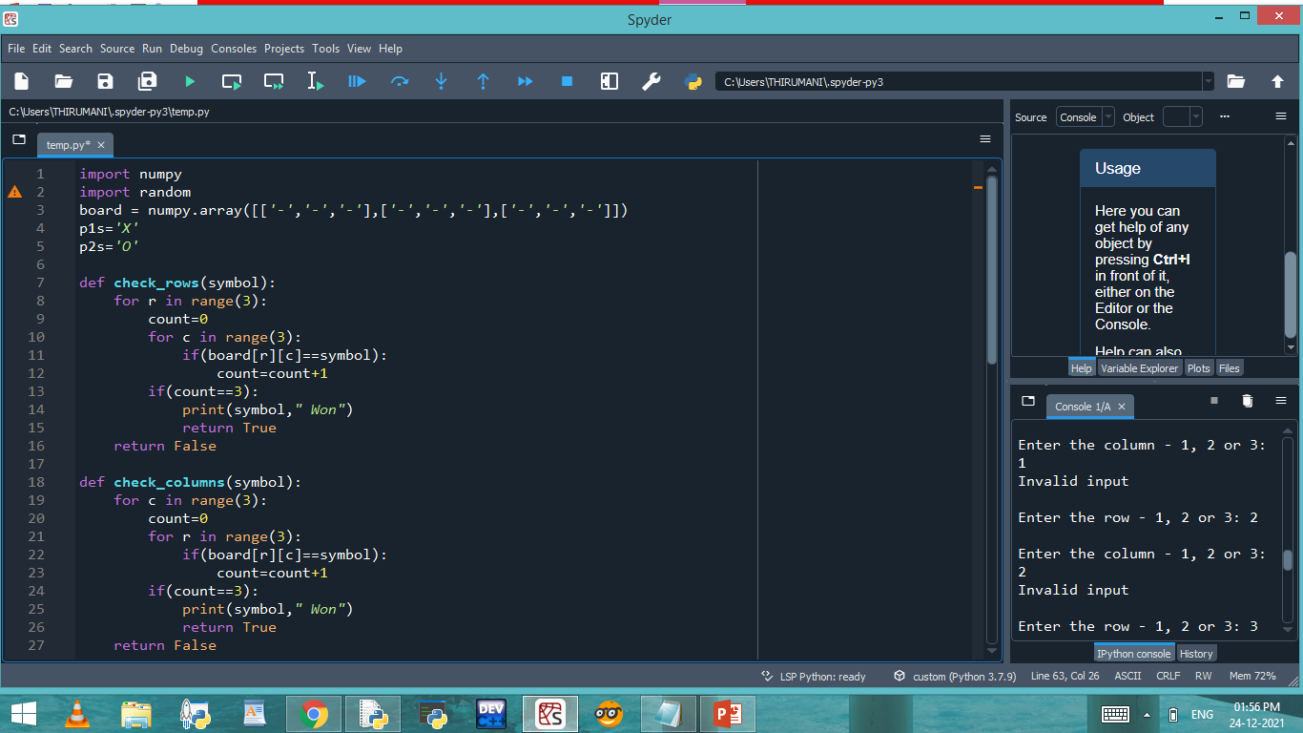
CODE:

Slide 4
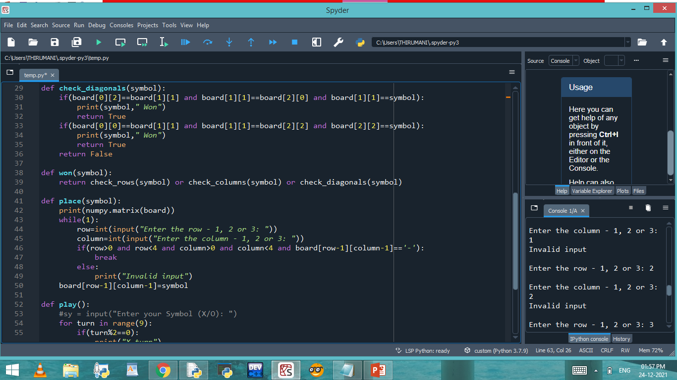

Slide 5
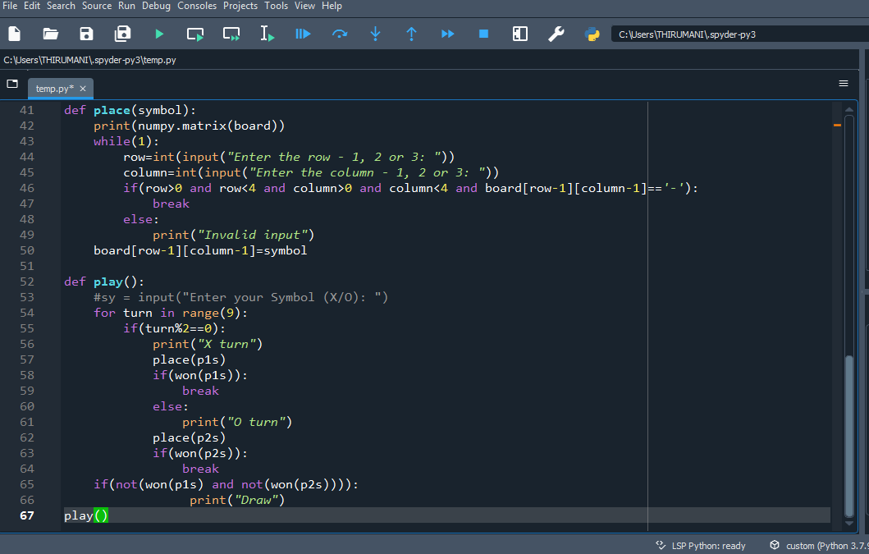

Slide 6
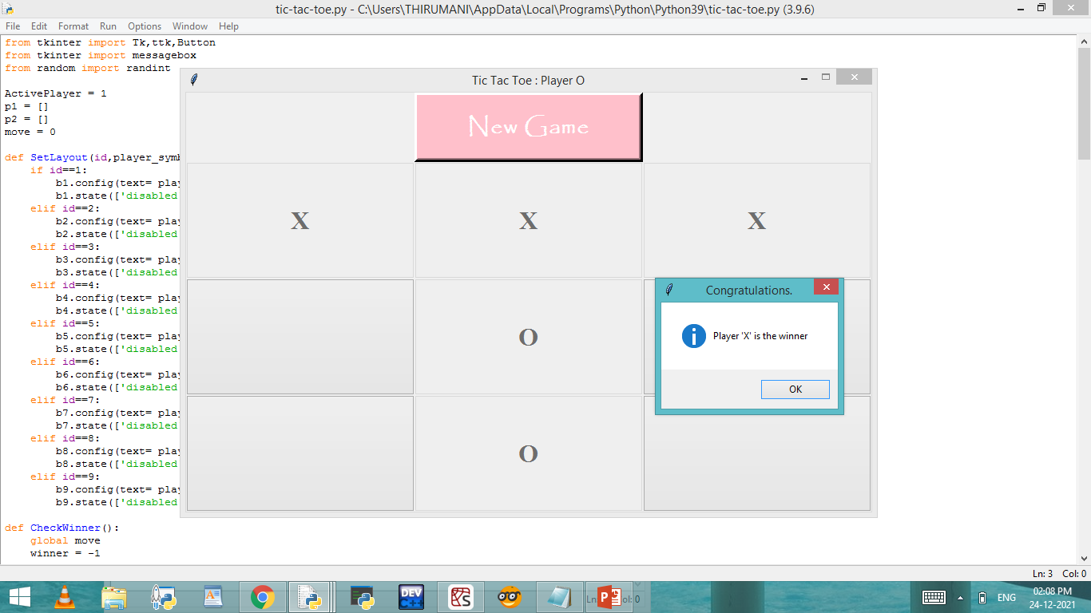
OUTPUT:

Slide 7
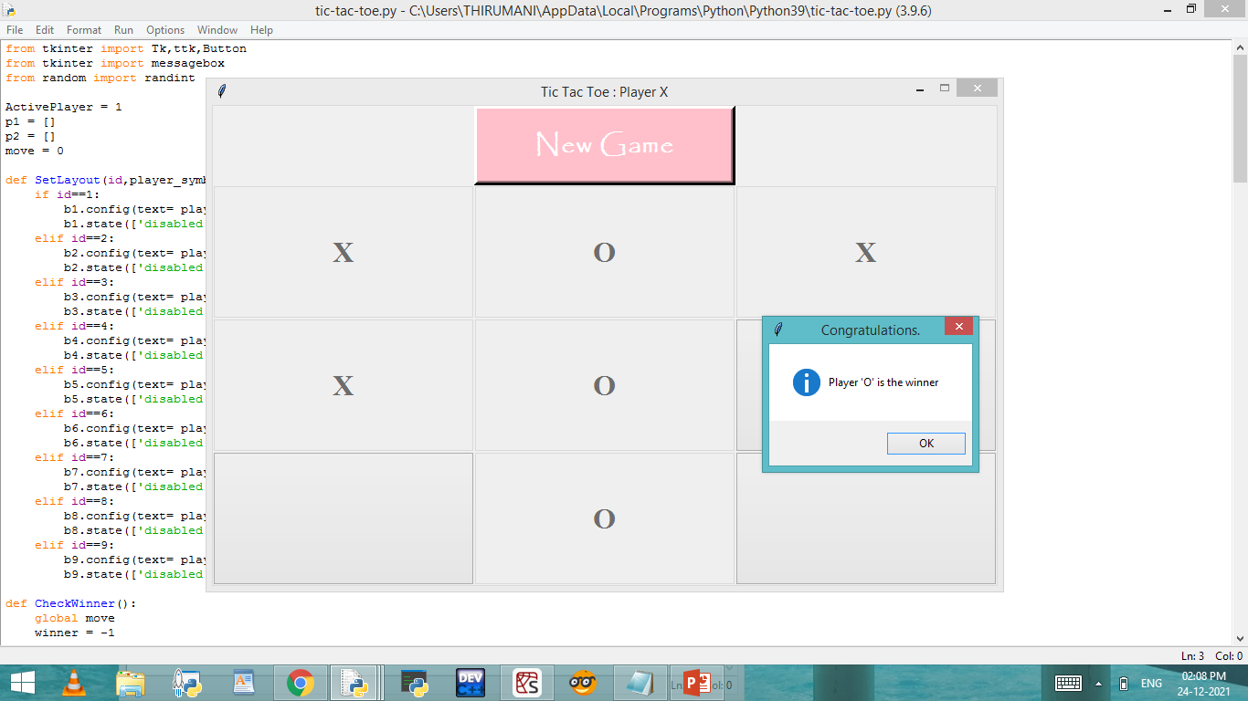

Slide 8
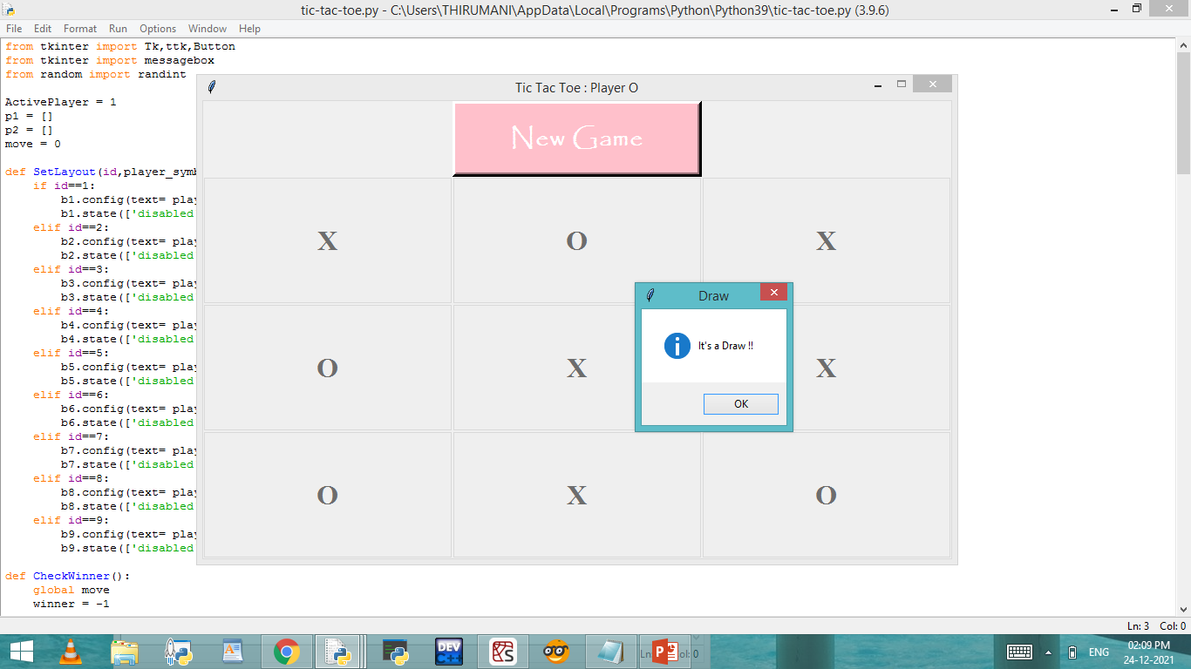

Slide 9
CONCLUSION:
Here, the two player game
(Tic-Tac-Toe) is implemented using Python language and Graphical User Interface using the tool Tkinter.

